Slide 1
Introduction to Transformer
Quang Duong

Slide 2
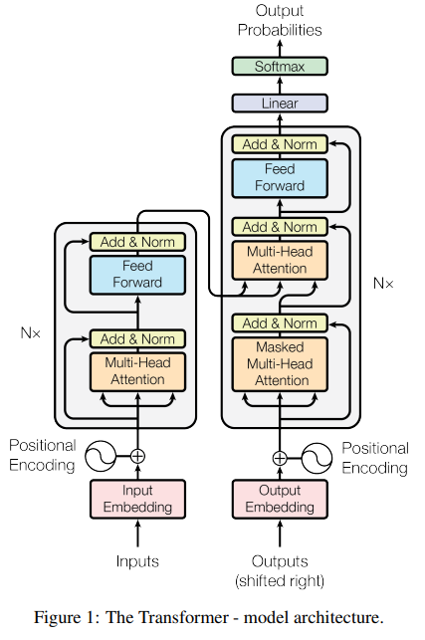
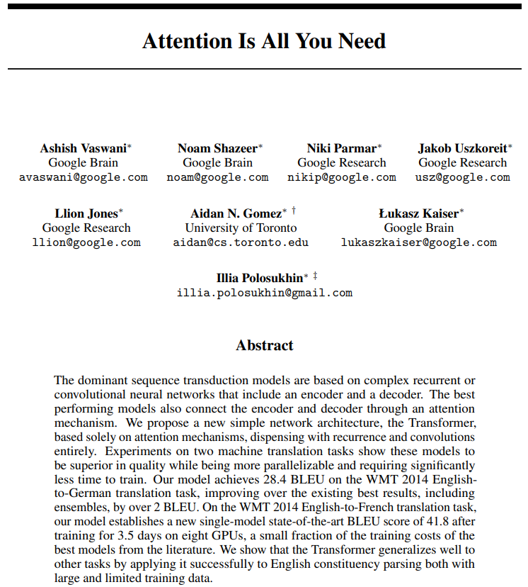
Transformer
Attention Is All You Need, A. Vaswani et al, 2017, https://arxiv.org/abs/1706.03762

Slide 3
NLP until 2017
Recurrent Neural Networks
Long Short-Term Memory (LSTM) networks
Gated Recurrent Units (GRU)
2017

Slide 4
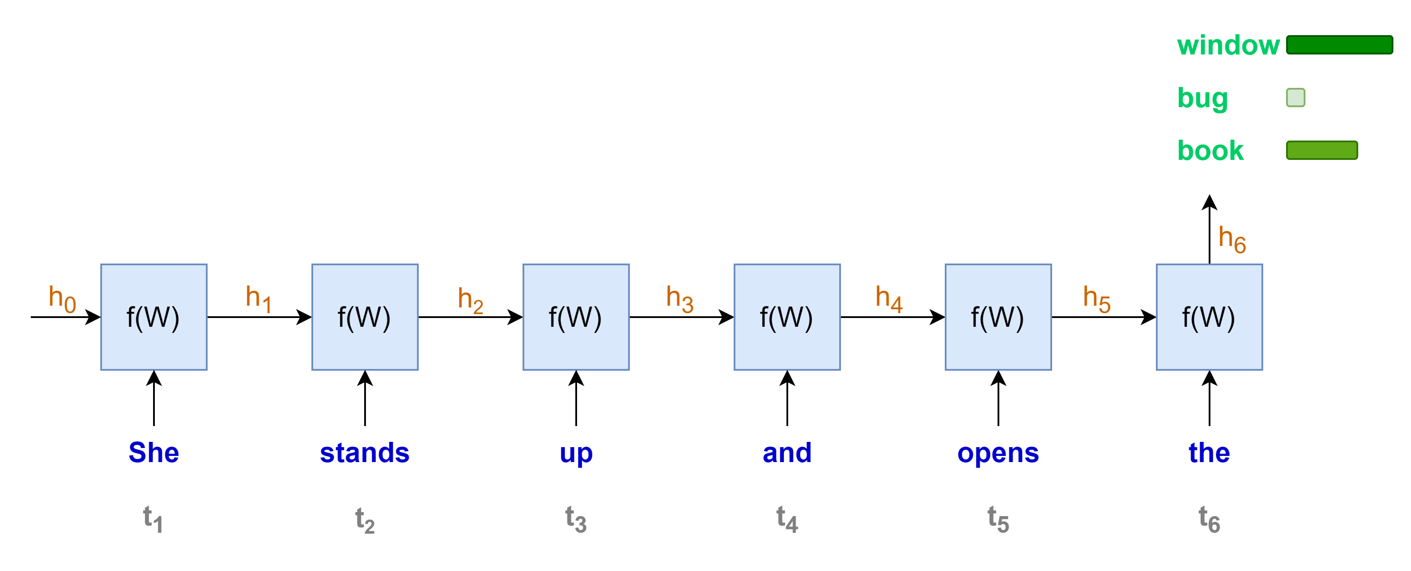
Language modeling with RNNs
“She stands up and opens the …………..”
Sequential computation, one word at a time
Less rooms for parallel computation
Longer sequence, longer computation time

Slide 5
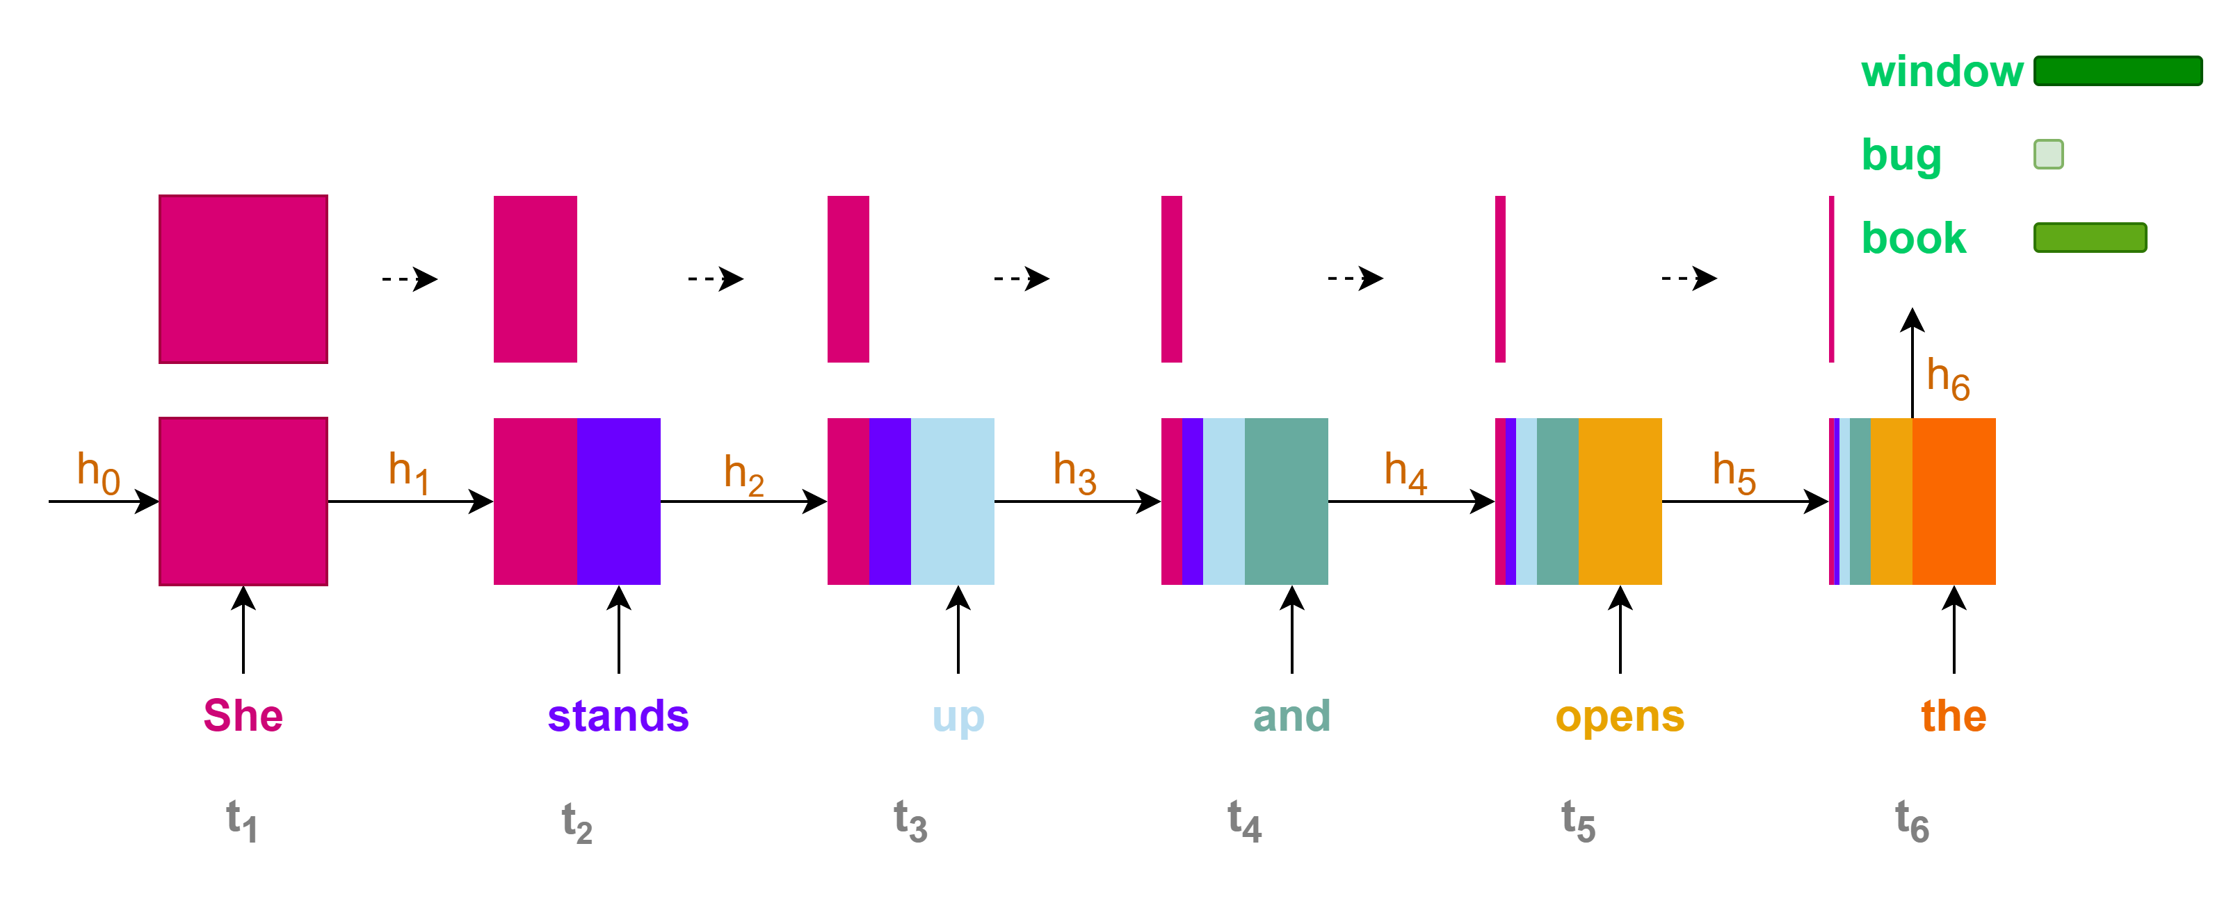
Language modeling with RNNs
Contributions of initial states or information to the final state or prediction are very small for long sequence context
Loss of information for long-range dependencies

Slide 6
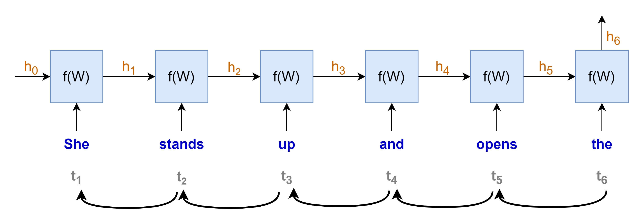
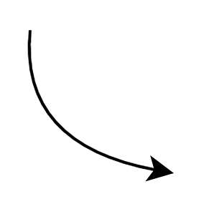
















Language modeling with RNNs
$$gradient products$$
$$\frac{∂h_{t}}{∂h_{t−1}}≪1 →very small→"vanished"$$
$$\frac{∂h_{1}}{∂W}$$
$$\frac{∂h_{2}}{∂h_{1}}$$
$$\frac{∂h_{3}}{∂h_{2}}$$
$$\frac{∂h_{4}}{∂h_{3}}$$
$$\frac{∂h_{5}}{∂h_{4}}$$
$$\frac{∂h_{6}}{∂h_{5}}$$
$$×$$
$$×$$
$$×$$
$$×$$
$$×$$
$$\frac{∂h_{t}}{∂h_{t−1}}≫1 →very large→"exploded"$$
$$\frac{∂L}{∂W}=\frac{∂L}{∂y}\frac{∂y}{∂h_{6}}$$
$$×$$
“chain rule”
Training with Backpropagation Through Time
Vanishing or exploding gradients
Unstable training

Slide 7
NLP until 2017
Recurrent Neural Networks
Long Short-Term Memory (LSTM) networks
Gated Recurrent Units (GRU)
2017
Inconvenient:
Sequential computation, hard to parallel computation with GPU
Loss of information for long-term dependencies
Vanishing problem

Slide 8
The arrival of Transformer
2017
Recurrent Neural Networks
Long Short-Term Memory (LSTM) networks
Gated Recurrent Units (GRU)
Transformer
Inconvenient:
Sequential computation, hard to parallel computation with GPU
Loss of information for long-term dependencies
Vanishing problem
With self-attention mechanism (among others), allows:
Parallel computation → leverage GPU
Capture long-range dependencies
Less prone to vanishing or exploding gradient problems

Slide 9
NLP timeline
2017
2018
Recurrent Neural Networks
Long Short-Term Memory (LSTM) networks
Gated Recurrent Units (GRU)
Transformer
Pre-trained language models
BERT
GPT
T5
Llama
Mistral
Phi
Falcon
OLMo
…

Slide 10


Transformer for lingual translation
Prediction:
"Je vais bien"
Transformer
Decoder
Encoder
Source:
"I am fine"
Simplified transformer architecture

Slide 11
Model requirements for data input
Source:
Target/Label:
"I am fine"
"Je vais bien"
"Thank you very much"
"Merci beaucoup"
"I cook French cuisine"
"Je fais la cuisine française"
Model only understand numerical value -> transform from text to numerical representation
Source and target texts may have different word length -> A fixed sequence length is needed for the model processing
Model need to know when to start and notify when to end its prediction

Slide 12
Tokenizer
Contain large vocabulary dictionary
Transform text to numerical representation
Special tokens
UNK: Unkown
PAD: Padding
SOS: Start Of Sentence
EOS: End Of Sentence
{
…
"vocab": {
"[UNK]": 0,
"[PAD]": 1,
"[SOS]": 2,
"[EOS]": 3,
"I" : 9,
"you": 24,
"very": 75,
"am" : 107,
"much": 120,
"fine": 550,
"French": 582
"cook": 1779,
"Thank": 2089,
}
…
}
tokenizer

Slide 13
Tokenizer – Source language – Encode
Tokenizer
encode
"I am fine"
[9, 107, 550]
{
…
"vocab": {
"[UNK]": 0,
"[PAD]": 1,
"[SOS]": 2,
"[EOS]": 3,
"I" : 9,
"you": 24,
"very": 75,
"am" : 107,
"much": 120,
"fine": 550,
"French": 582
"cook": 1779,
"Thank": 2089,
}
…
}
> text = "I am fine"
> tokenizer_source.encode(text).ids
# [9, 107, 550]
tokenizer_source

Slide 14
Tokenizer – Source language – Decode
Tokenizer
decode
[9, 107, 550]
"I am fine"
{
…
"vocab": {
"[UNK]": 0,
"[PAD]": 1,
"[SOS]": 2,
"[EOS]": 3,
"I" : 9,
"you": 24,
"very": 75,
"am" : 107,
"much": 120,
"fine": 550,
"French": 582
"cook": 1779,
"Thank": 2089,
}
…
}
> id_list = [9, 107, 550]
> tokenizer_source.decode(id_list)
# "I am fine"
tokenizer_source

Slide 15
Tokenizer – Target language - Encode
Tokenizer
encode
"Je vais bien"
[69, 600, 71]
{
…
"vocab": {
"[UNK]": 0,
"[PAD]": 1,
"[SOS]": 2,
"[EOS]": 3,
"la": 9,
"Je": 69 ,
"bien": 71,
"beaucoup": 324,
"vais": 600,
"fais": 1355,
"cuisine": 1390,
"Merci": 3546,
"française": 5309,
}
…
}
> text = "Je vais bien"
> tokenizer_target.encode(text).ids
# [69, 600, 71]
tokenizer_target

Slide 16
Tokenizer – Target language - Decode
Tokenizer
decode
[69, 600, 71]
"Je vais bien"
{
…
"vocab": {
"[UNK]": 0,
"[PAD]": 1,
"[SOS]": 2,
"[EOS]": 3,
"la": 9,
"Je": 69 ,
"bien": 71,
"beaucoup": 324,
"vais": 600,
"fais": 1355,
"cuisine": 1390,
"Merci": 3546,
"française": 5309,
}
…
}
> id_list = [69, 600, 71]
> tokenizer_target.decode(id_list)
# "Je vais bien"
tokenizer_target

Slide 17

Fixed sequence length – SOS, EOS, PAD
Source (max length: 4)
"I am fine"
"Thank you very much"
"I cook French cuisine"
Target (max length: 5)
"Je vais bien"
"Merci beaucoup"
"Je fais la cuisine française"
For decoder input
For loss calculation
For encoder input
SOS
I
am
fine
EOS
PAD
PAD
SOS
Thank
you
very
much
EOS
PAD
SOS
I
cook
French
cuisine
EOS
PAD
SOS
Je
vais
bien
PAD
PAD
PAD
SOS
Merci
beaucoup
PAD
PAD
PAD
PAD
SOS
Je
fais
la
cuisine
française
PAD
Je
vais
bien
EOS
PAD
PAD
PAD
Merci
beaucoup
EOS
PAD
PAD
PAD
PAD
Je
fais
la
cuisine
française
EOS
PAD
$seq$=7

Slide 18
Put it all together (1/3)
Source (max length: 4)
"I am fine"
"Thank you very much"
"I cook French cuisine"
Fixed length, SOS, EOS
For encoder input
SOS
I
am
fine
EOS
PAD
PAD
SOS
Thank
you
very
much
EOS
PAD
SOS
I
cook
French
cuisine
EOS
PAD
2
9
107
550
3
1
1
2
2089
95
75
120
3
1
2
9
1779
582
0
3
1
$seq$=7
Source Tokenizer
encodes

Slide 19
Put it all together (2/3)
Target (max length: 5)
"Je vais bien"
"Merci beaucoup"
"Je fais la cuisine française"
Fixed length, SOS, EOS
For encoder input
SOS
Je
vais
bien
PAD
PAD
PAD
SOS
Merci
beaucoup
PAD
PAD
PAD
PAD
SOS
Je
fais
la
cuisine
française
PAD
2
69
600
71
1
1
1
2
3546
324
1
1
1
1
2
69
1355
9
1390
5309
1
$seq$=7
Target Tokenizer
encodes

Slide 20
Put it all together (3/3)
Target (max length: 5)
"Je vais bien"
"Merci beaucoup"
"Je fais la cuisine française"
69 | 600 | 71 | 3 | 1 | 1 | 1
3546 | 324 | 3 | 1 | 1 | 1 | 1
69 | 1355 | 9 | 1390 | 5309 | 3 | 1
Fixed length, SOS, EOS
For encoder input
Je
vais
bien
EOS
PAD
PAD
PAD
Merci
beaucoup
EOS
PAD
PAD
PAD
PAD
Je
fais
la
cuisine
française
EOS
PAD
69
600
71
3
1
1
1
3546
324
3
1
1
1
1
69
1355
9
1390
5309
3
1
$seq$=7
Target Tokenizer
encodes

Slide 21
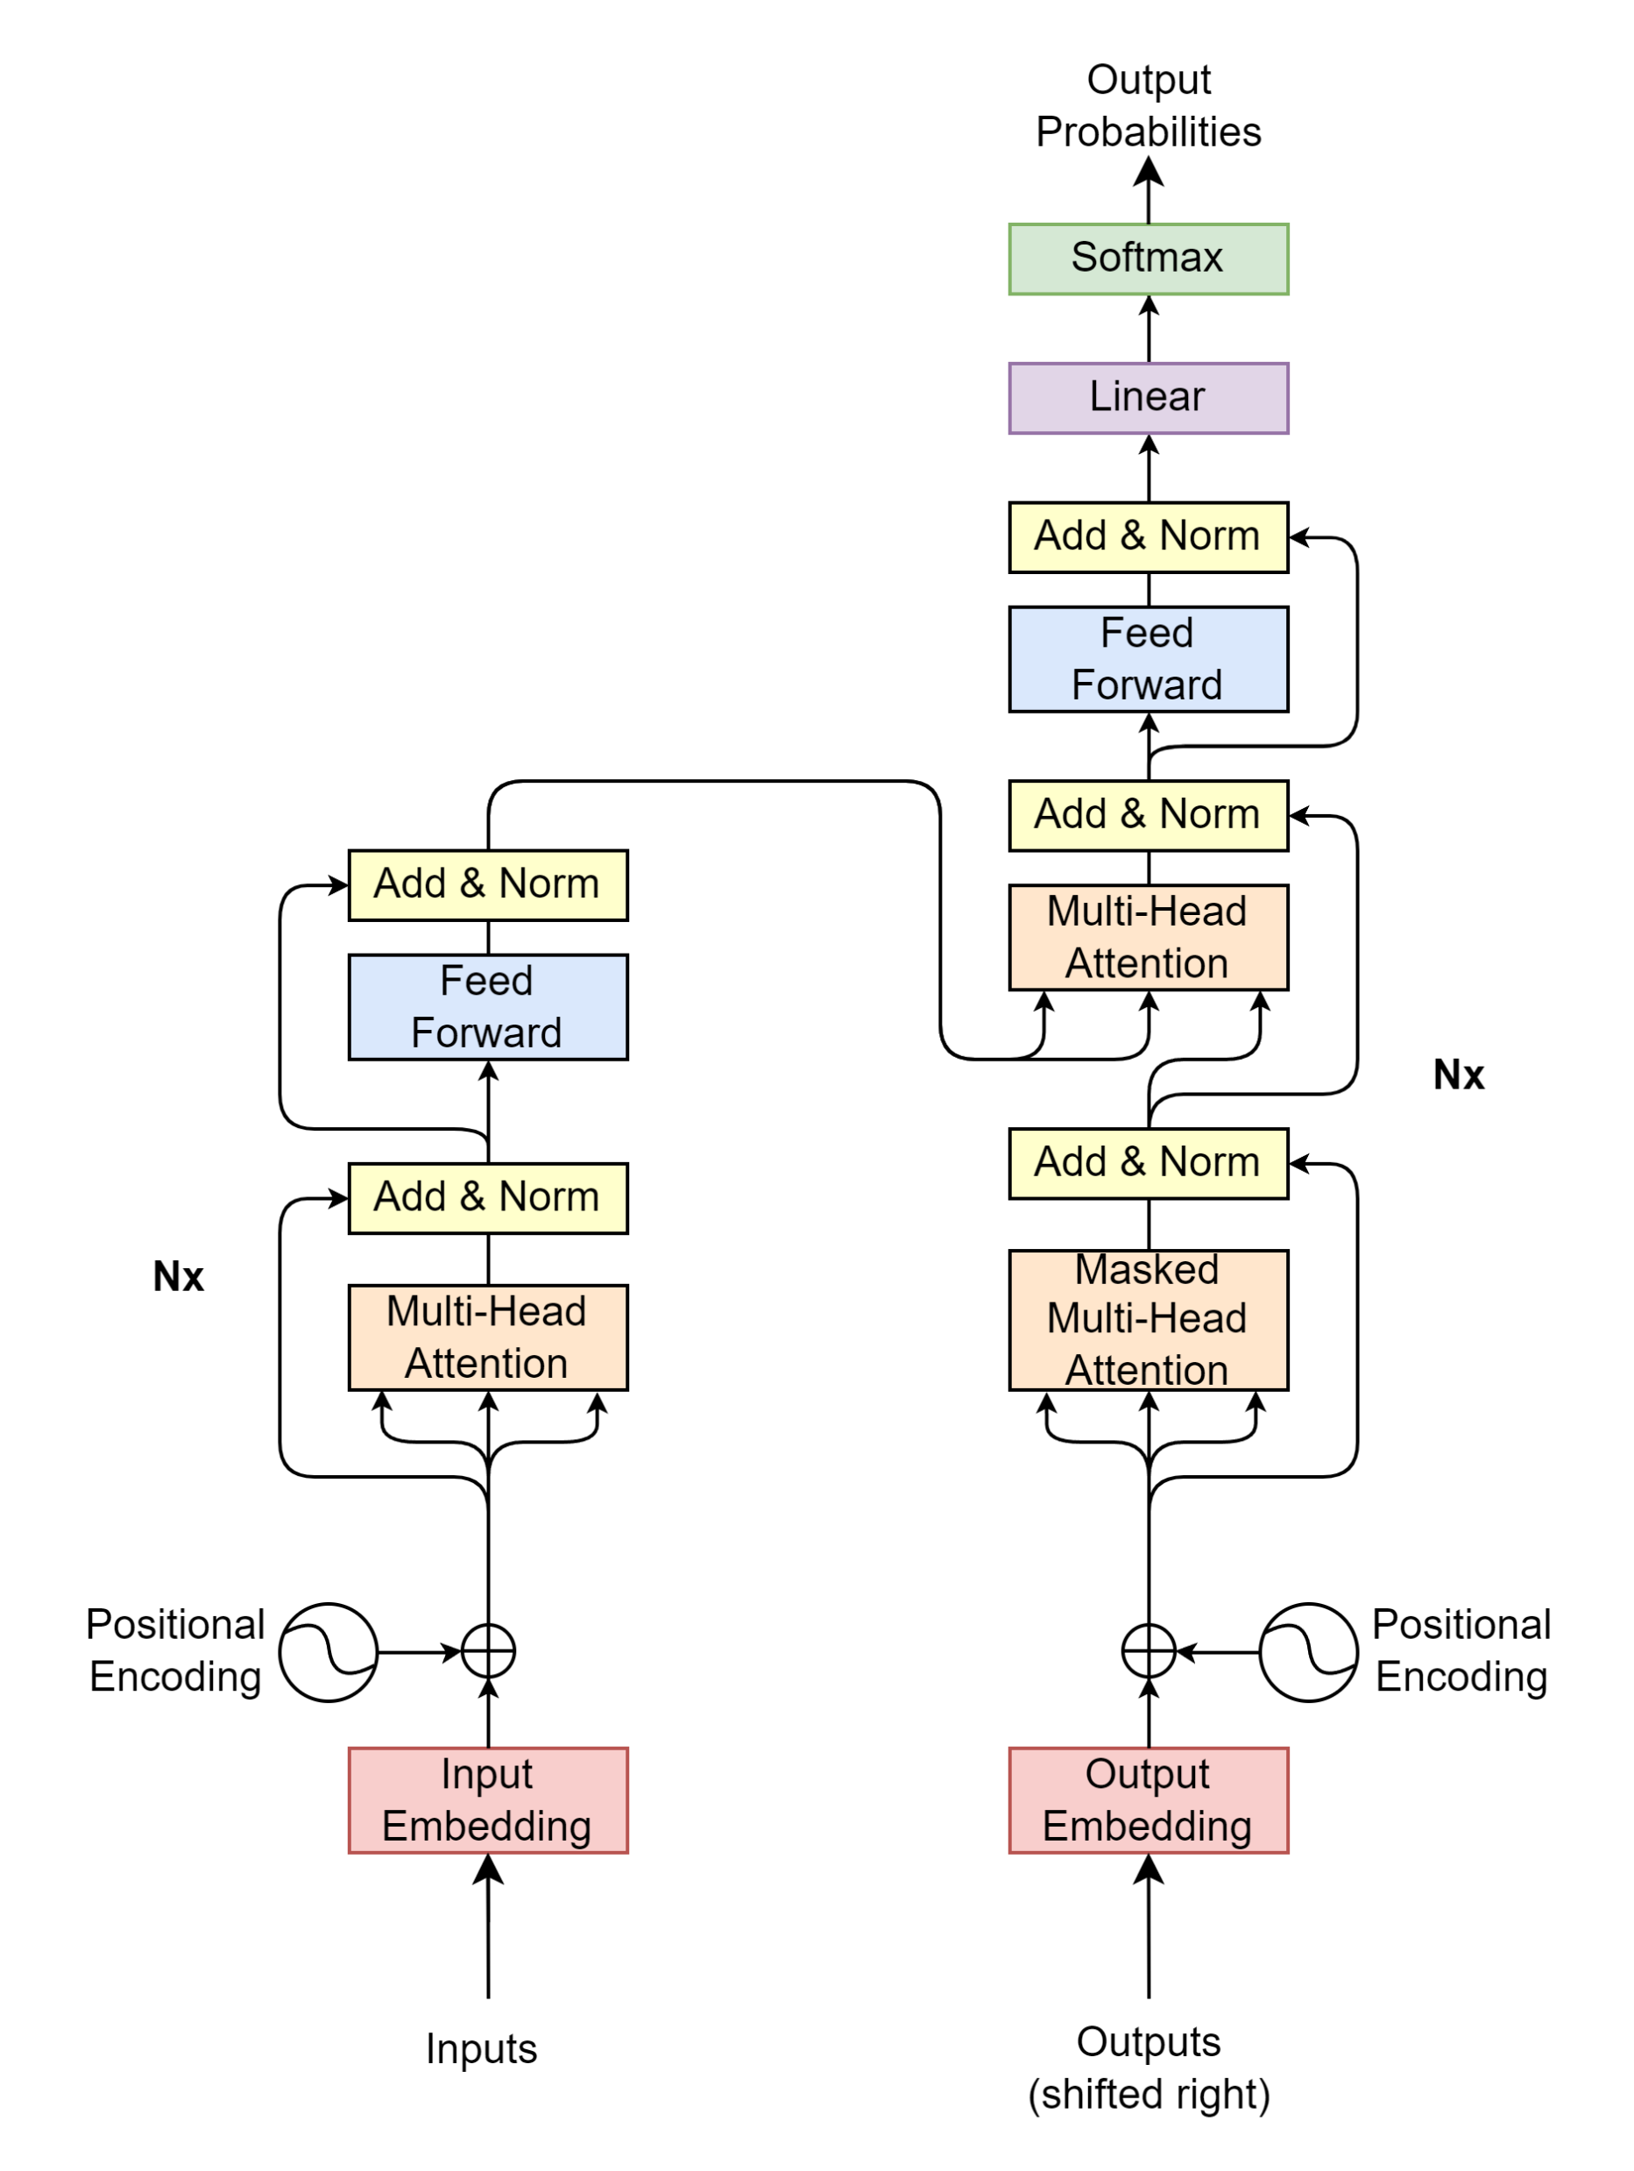

Transformer blocks
2
9
107
550
3
1
1
2
2089
95
75
120
3
1
2
9
1779
582
0
3
1
2
69
600
71
1
1
1
2
3546
324
1
1
1
1
2
69
1355
9
1390
5309
1

Slide 22
Transformer blocks
Projection
Decoder
Encoder
Encoder Input
Decoder Input

Slide 23



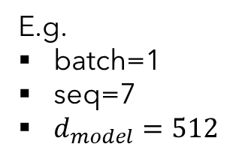



Encoder Input
Encoder Input
Positional
Encoding
$$\left(batch, seq, d_{model}\right)$$
E.g.
batch=1
seq=7
$d_{model}=512$
$$\left(batch, seq, d_{model}\right)$$
$$\left(batch, seq, d_{model}\right)$$
Input Embedding
Inputs
$$\left(batch, seq\right)$$
SOS
I
am
fine
EOS
PAD
PAD
2
9
107
550
3
1
1
"I am fine"

Slide 24
Input Embedding
E.g.
batch=1
seq=7
$d_{model}=512$
$$\left(batch, seq, d_{model}\right)$$
Input Embedding
Inputs
$$\left(batch, seq\right)$$
SOS
I
am
fine
EOS
PAD
PAD
2
9
107
550
3
1
1
"I am fine"

Slide 25



Input Embedding
$$d_{model}$$
… | … | … | … | …
523.415 | 1265.142 | … | 4189.251 | 16.416
452.716 | 6234.624 | … | 412.414 | 1794.127
7745.984 | 1314.124 | … | 65.764 | 1543.345
… | … | … | … | …
… | … | … | … | …
… | … | … | … | …
$$seq$$
E.g.
batch=1
seq=7
$d_{model}=512$
$$\left(batch, seq, d_{model}\right)$$
Input Embedding
Inputs
$$\left(batch, seq\right)$$
SOS
I
am
fine
EOS
PAD
PAD
2
9
107
550
3
1
1
"I am fine"
$$seq$$

Slide 26













Positional Encoding
$$d_{model}$$
$$i=0$$
$$i=1$$
$$⋯$$
$$i=d_{model}−1$$
… | … | … | … | …
PE(1,0) | PE(1,1) | … | PE(1,510) | PE(1, 511)
PE(2,0) | PE(2,1) | … | PE(2,510) | PE(2, 511)
PE(3,0) | PE(3,1) | … | PE(3,510) | PE(3, 511)
… | … | … | … | …
… | … | … | … | …
… | … | … | … | …
$$pos=0$$
$pos=$1
$$⋮$$
$$seq$$
E.g.
batch=1
seq=7
$d_{model}=512$
$$pos$$
$$=seq−1$$
$$\left(batch, seq, d_{model}\right)$$
PE$\left(pos, 2i\right)=\sin\left(\frac{pos}{{10000}^{\frac{2i}{d_{model}}}}\right)$
Positional
Encoding
PE$\left(pos, 2i+1\right)=\cos\left(\frac{pos}{{10000}^{\frac{2i}{d_{model}}}}\right)$
Inputs
$$\left(batch, seq\right)$$
SOS
I
am
fine
EOS
PAD
PAD
2
9
107
550
3
1
1
"I am fine"
$$seq$$

Slide 27
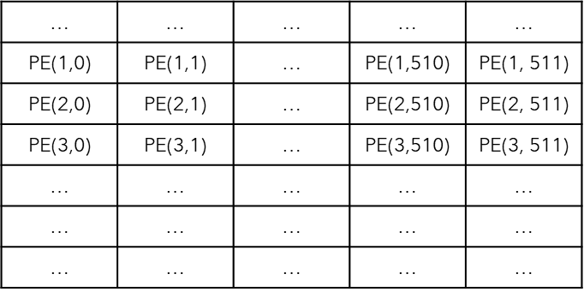
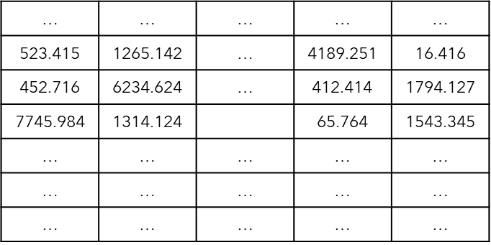








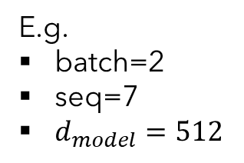


Encoder Input
Encoder Input
E.g.
batch=2
seq=7
$d_{model}=512$
Positional
Encoding
$$\left(batch, seq, d_{model}\right)$$
$$\left(batch, seq, d_{model}\right)$$
$$d_{model}$$
$$\left(batch, seq, d_{model}\right)$$
Input Embedding
$$seq$$
Inputs
$$batch$$
$$\left(batch, seq\right)$$
SOS
I
am
fine
EOS
PAD
PAD
SOS
Thank
you
very
much
EOS
PAD
2
9
107
550
3
1
1
2
2089
95
75
120
3
1
$$batch$$
$$batch$$
"I am fine"
"Thank you very much"
$$seq$$

Slide 28
Transformer blocks
Projection
Decoder
Encoder
Encoder Input
Decoder Input

Slide 29
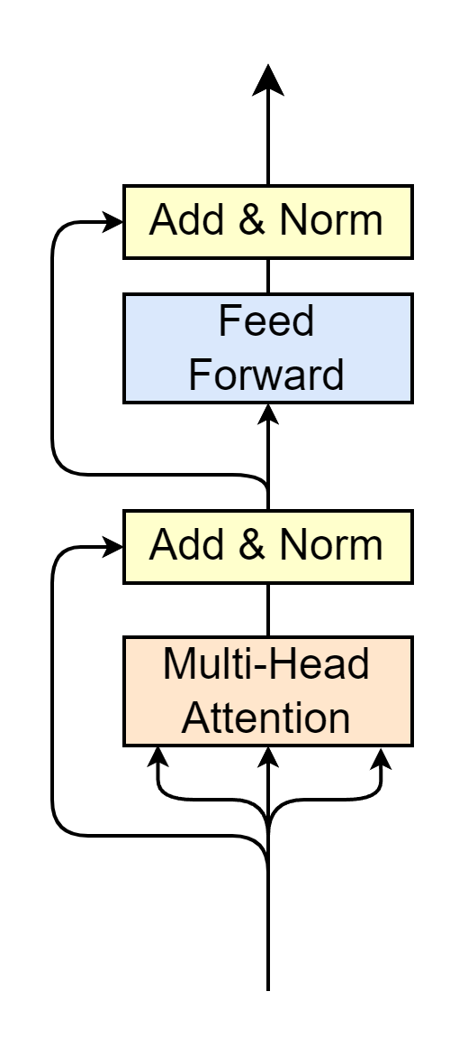



Encoder
Encoder Output
$$\left(batch, seq, d_{model}\right)$$
Multi-Head Attention
Self-Attention
Layer Normalization
Feed Forward
Residual connection
Residual Connection
$$N_{x}$$
… | … | … | … | …
1813.456 | 1665.569 | … | 5327.367 | 435.167
652.881 | 2434.715 | … | 846.846 | 2678.246
8945.944 | 2413.412 | … | 842.416 | 1964.597
… | … | … | … | …
… | … | … | … | …
… | … | … | … | …
… | … | … | … | …
523.415 | 1265.142 | … | 4189.251 | 16.416
452.716 | 6234.624 | … | 412.414 | 1794.127
7745.984 | 1314.124 |  | 65.764 | 1543.345
… | … | … | … | …
… | … | … | … | …
… | … | … | … | …
Encoder Input
$$\left(batch, seq, d_{model}\right)$$

Slide 30
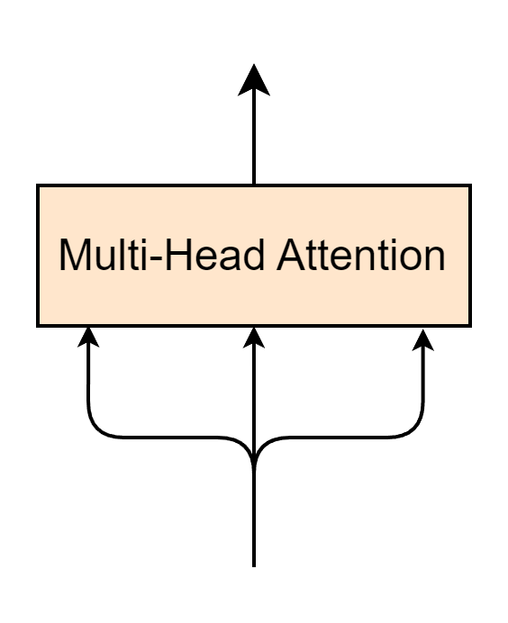
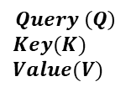









Multi-Head Attention Layer
$$\left(batch, seq, d_{model}\right)$$
$$Q$$
$$K$$
$$V$$
… | … | … | … | …
1813.456 | 1665.569 | … | 5327.367 | 435.167
652.881 | 2434.715 | … | 846.846 | 2678.246
8945.944 | 2413.412 | … | 842.416 | 1964.597
… | … | … | … | …
… | … | … | … | …
… | … | … | … | …
Encoder Input
… | … | … | … | …
523.415 | 1265.142 | … | 4189.251 | 16.416
452.716 | 6234.624 | … | 412.414 | 1794.127
7745.984 | 1314.124 |  | 65.764 | 1543.345
… | … | … | … | …
… | … | … | … | …
… | … | … | … | …
$$\left(batch, seq, d_{model}\right)$$
$$Query \left(Q\right)$$
$$Key(K)$$
$$Value(V)$$
$$seq$$
$$≡$$
$$batch$$
$$d_{model}$$

Slide 31
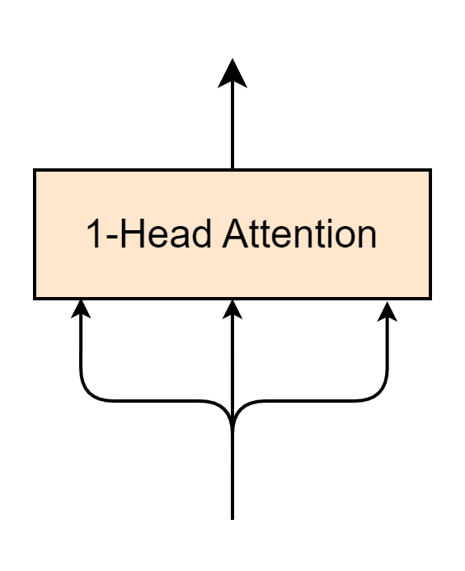

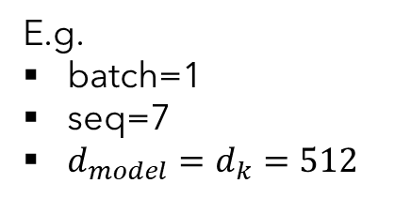

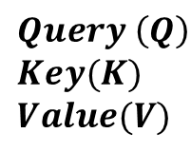
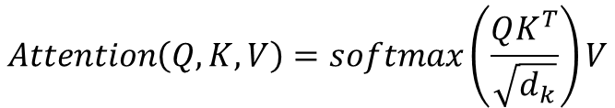





1-Head Attention Layer
E.g.
batch=1
seq=7
$d_{model}=d_{k}=512$
$$\left(batch, seq, d_{model}\right)$$
$$Attention\left(Q, K, V\right)=softmax\left(\frac{QK^{T}}{\sqrt{d_{k}}}\right)V$$
$$Q$$
$$K$$
$$V$$
Encoder Input
$$\left(batch, seq, d_{model}\right)$$
… | … | … | … | …
1813.456 | 1665.569 | … | 5327.367 | 435.167
652.881 | 2434.715 | … | 846.846 | 2678.246
8945.944 | 2413.412 | … | 842.416 | 1964.597
… | … | … | … | …
… | … | … | … | …
… | … | … | … | …
$$Query \left(Q\right)$$
$$Key(K)$$
$$Value(V)$$
$$seq$$
$$≡$$
$$d_{model}$$

Slide 32

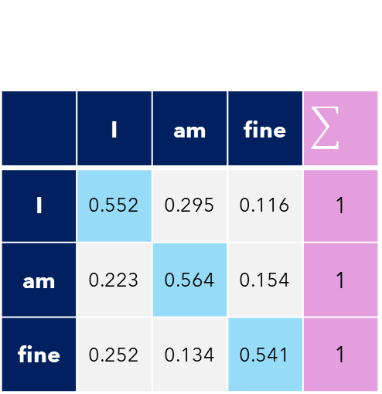

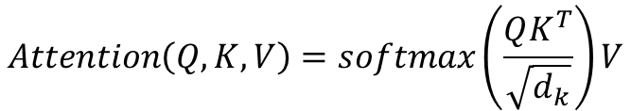




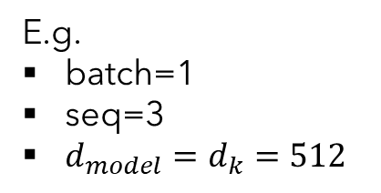

Self-Attention
Self-Attention
E.g.
batch=1
seq=3
$d_{model}=d_{k}=512$
$$Attention\left(Q, K, V\right)=softmax\left(\frac{QK^{T}}{\sqrt{d_{k}}}\right)V$$
$$Q(3, 512)$$
$$K^{T}(512,3)$$
1813.456 | 652.881 | 8945.944
1665.569 | 2434.715 | 2413.412
… | … | …
5327.367 | 846.846 | 842.416
435.167 | 2678.246 | 1964.597
Self-Attention$(3,3)$
1813.456 | 1665.569 | … | 5327.367 | 435.167
652.881 | 2434.715 | … | 846.846 | 2678.246
8945.944 | 2413.412 | … | 842.416 | 1964.597
$$softmax$$
$$×$$
 | I | am | fine
I | 0.552 | 0.295 | 0.116 | 1
am | 0.223 | 0.564 | 0.154 | 1
fine | 0.252 | 0.134 | 0.541 | 1
$$=$$
$$\sqrt{512}$$
Self-attention -> Relate words to each others

Slide 33





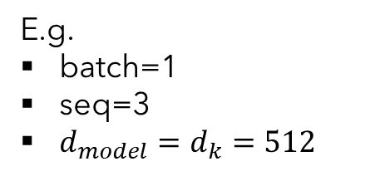

1-Head Attention Layer
Self-Attention
E.g.
batch=1
seq=3
$d_{model}=d_{k}=512$
$$Attention\left(Q, K, V\right)=softmax\left(\frac{QK^{T}}{\sqrt{d_{k}}}\right)V$$
Self-Attention$(3,3)$
 | I | am | fine
I | 0.552 | 0.295 | 0.116 | 1
am | 0.223 | 0.564 | 0.154 | 1
fine | 0.252 | 0.134 | 0.541 | 1
V$(3, 512)$
Attention$(3, 512)$
1813.456 | 1665.569 | … | 5327.367 | 435.167
652.881 | 2434.715 | … | 846.846 | 2678.246
8945.944 | 2413.412 | … | 842.416 | 1964.597
… | … | … | … | …
… | … | … | … | …
… | … | … | … | …
$$×$$
$$=$$
"Word meaning + position feature"
"Word meaning + position feature"
"Relate words to each others"
"Relate words to each others"

Slide 34
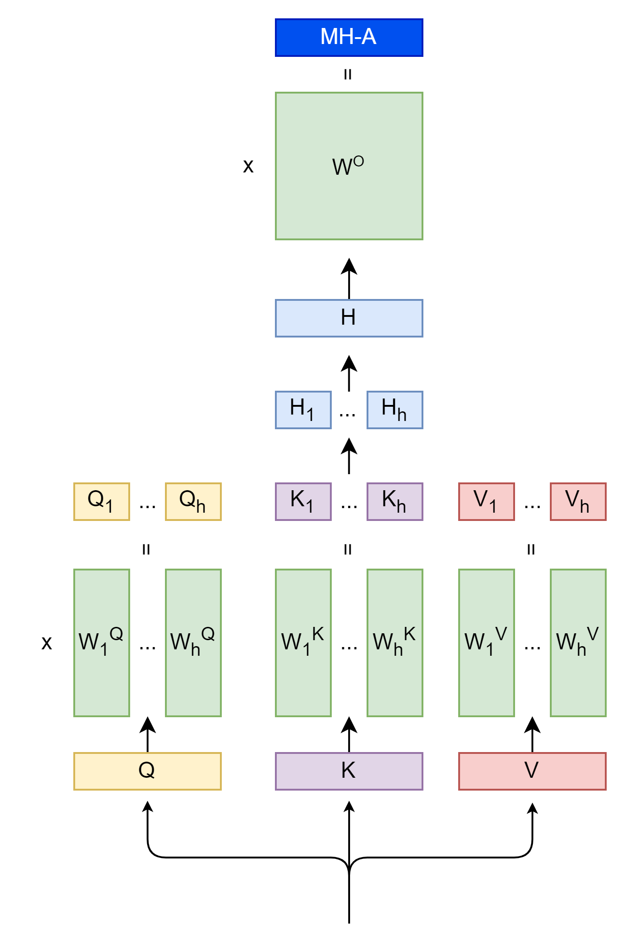
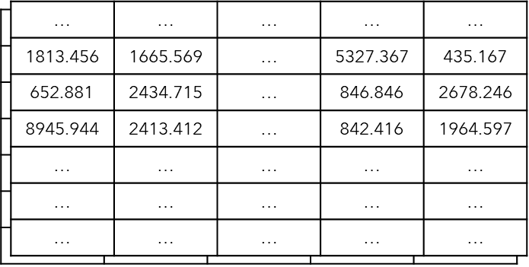










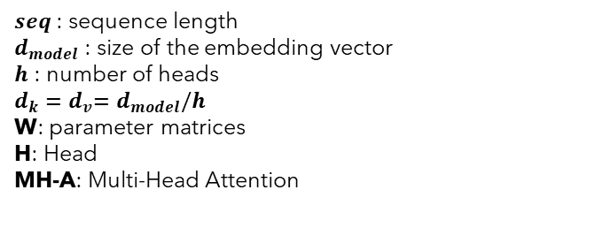




Multi-Head Attention
$$Attention\left(Q, K, V\right)=softmax\left(\frac{QK^{T}}{\sqrt{d_{k}}}\right)V$$
$$\left(batch, seq, d_{model}\right)$$
$seq$ : sequence length
$d_{model}$ : size of the embedding vector
$h$ : number of heads
$d_{k}{=d}_{v}=d_{model}/h$
W: parameter matrices
H: Head
MH-A: Multi-Head Attention
$$\left(batch,d_{model}, d_{model}\right)$$
$$Concat\left(head_{1},⋯,head_{h}\right)$$
$$\left(batch, seq, d_{model}\right)$$
$${Head}_{i}=Attention\left(QW_{i}^{Q},KW_{i}^{K},VW_{i}^{V}\right)$$
$$\left(batch, seq, d_{v}\right)$$
$$\left(batch, seq, d_{k}\right)$$
$$\left(batch,d_{model}, d_{k}\right)$$
$$batch$$
$$d_{model}$$
$$\left(batch, seq, d_{model}\right)$$
$$seq$$
Encoder Input
$$\left(batch, seq, d_{model}\right)$$

Slide 35
Encoder
Encoder Output
$$\left(batch, seq, d_{model}\right)$$
Multi-Head Attention
Self-Attention
Layer Normalization
Feed Forward
Residual connection
Residual Connection
$$N_{x}$$
Encoder Input
$$\left(batch, seq, d_{model}\right)$$

Slide 36

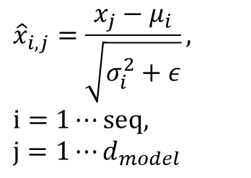

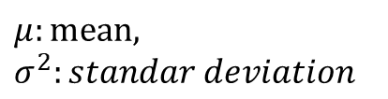



Layer Normalization
$${\hat{x}}_{i,1}$$
$${\hat{x}}_{{i,d}_{model}}$$
 |  | …
$${\hat{x}}_{i,j}=\frac{x_{j}−μ_{i}}{\sqrt{σ_{i}^{2}+ε}},$$
$$i=1⋯seq,$$
$$j=1⋯d_{model}$$
Layer Normalization
$$μ:mean,$$
$$σ^{2}:standar deviation$$
$$Token_{i}$$
$$x_{i,1}$$
$$x_{{i,d}_{model}}$$
 |  | …

Slide 37
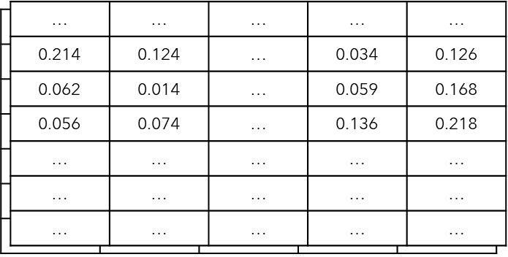

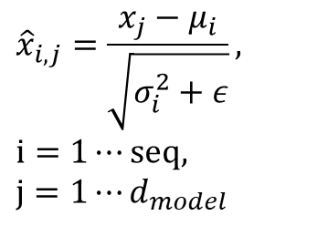


Layer Normalization
$$\left(batch, seq,d_{model}\right)$$
$${\hat{x}}_{i,j}=\frac{x_{j}−μ_{i}}{\sqrt{σ_{i}^{2}+ε}},$$
$$i=1⋯seq,$$
$$j=1⋯d_{model}$$
Layer Normalization
$$\left(batch, seq,d_{model}\right)$$
$$batch$$
$$seq$$
$$d_{model}$$

Slide 38
Encoder
Encoder Output
$$\left(batch, seq, d_{model}\right)$$
Multi-Head Attention
Self-Attention
Layer Normalization
Feed Forward
Residual connection
Residual Connection
$$N_{x}$$
Encoder Input
$$\left(batch, seq, d_{model}\right)$$

Slide 39
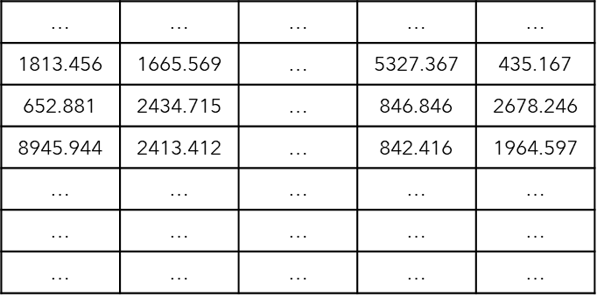



















Feed Forward
$$W_{1}$$
$$W_{2}$$
$$FFN\left(x\right)=$$
$$x$$
$$×$$
$$+$$
$$b_{1}$$
$$×$$
$$+$$
$$b_{2}$$
$$ReLU$$
$$\left(seq,d_{model}\right)$$
$$\left(d_{model},d_{ff}\right)$$
$$\left(d_{ff},d_{model}\right)$$
$$Linear Layer 1$$
$$\left(seq,d_{ff}\right)$$
$$Linear Layer 2$$
$$\left(seq,d_{model}\right)$$
$$x\left(seq,d_{model}\right)$$
$$seq$$
$$FFN\left(x\right)=max\left(0, xW_{1}+b_{1}\right)W_{2}+b_{2}$$
$$d_{model}$$

Slide 40
Encoder
Encoder Output
$$\left(batch, seq, d_{model}\right)$$
Multi-Head Attention
Self-Attention
Layer Normalization
Feed Forward
Residual connection
Residual Connection
$$N_{x}$$
Encoder Input
$$\left(batch, seq, d_{model}\right)$$

Slide 41




Residual Connection
$$output=x+sublayer(x)$$
$$+$$
$$Sublayer$$
$$x$$

Slide 42

Encoder
Encoder Output
$$\left(batch, seq, d_{model}\right)$$
Multi-Head Attention
Self-Attention
Layer Normalization
Feed Forward
Residual connection
Residual Connection
$N_{x}$=6
Encoder Input
$$\left(batch, seq, d_{model}\right)$$

Slide 43
Decoder
Projection
Decoder
Encoder
Encoder Input
Decoder Input

Slide 44
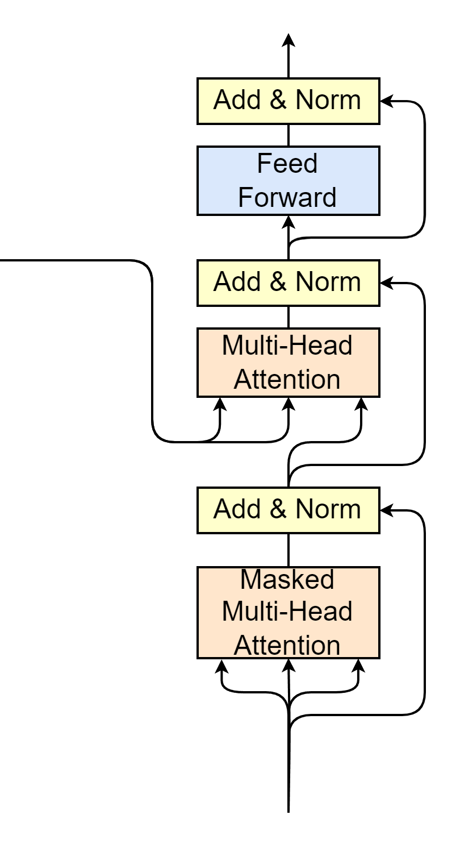






Decoder
Encoder output as Q and K of Multi-Head Attention
Masked Multi-Head Attention
Encoder Output
$$\left(batch, seq, d_{model}\right)$$
$$K$$
$$V$$
$$Q$$
$$N_{x}$$
Decoder Input
$$\left(batch, seq_{decoder}, d_{model}\right)$$

Slide 45
Masked Multi-Head Attention
 | This | Team | Is | The | Best | Team
This | 0.252 | 0.195 | 0.116 | 0.182 | 0.147 | 0.108
team | 0.123 | 0.264 | 0.154 | 0.165 | 0.172 | 0.122
Is | 0.152 | 0.134 | 0.241 | 0.156 | 0.154 | 0.163
The | 0.136 | 0.152 | 0.121 | 0.255 | 0.154 | 0.182
Best | 0.164 | 0.141 | 0.106 | 0.184 | 0.295 | 0.110
Team | 0.175 | 0.169 | 0.122 | 0.123 | 0.153 | 0.258

Slide 46






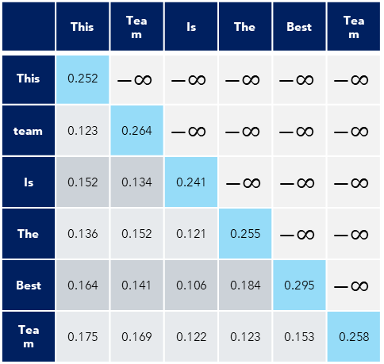


Masked Multi-Head Attention
$$Attention\left(Q, K, V\right)=softmax\left(\frac{QK^{T}}{\sqrt{d_{k}}}\right)V$$
 | This | Team | Is | The | Best | Team
This | 0.252 | $$−∞$$ | $$−∞$$ | $$−∞$$ | $$−∞$$ | $$−∞$$
team | 0.123 | 0.264 | $$−∞$$ | $$−∞$$ | $$−∞$$ | $$−∞$$
Is | 0.152 | 0.134 | 0.241 | $$−∞$$ | $$−∞$$ | $$−∞$$
The | 0.136 | 0.152 | 0.121 | 0.255 | $$−∞$$ | $$−∞$$
Best | 0.164 | 0.141 | 0.106 | 0.184 | 0.295 | $$−∞$$
Team | 0.175 | 0.169 | 0.122 | 0.123 | 0.153 | 0.258
$$\left(batch, seq, d_{model}\right)$$
$seq$ : sequence length
$d_{model}$ : size of the embedding vector
$h$ : number of heads
$d_{k}{=d}_{v}=d_{model}/h$
W: parameter matrices
H: Head
MH-A: Multi-Head Attention
$$\left(batch,d_{model}, d_{model}\right)$$
$$Concat\left(head_{1},⋯,head_{h}\right)$$
$$\left(batch, seq, d_{model}\right)$$
$${Head}_{i}=Attention\left(QW_{i}^{Q},KW_{i}^{K},VW_{i}^{V}\right)$$
$$\left(batch, seq, d_{v}\right)$$
$$\left(batch, seq, d_{k}\right)$$
$$\left(batch,d_{model}, d_{k}\right)$$
$$batch$$
$$d_{model}$$
$$\left(batch, seq, d_{model}\right)$$
$$seq$$
Encoder Input
$$\left(batch, seq_{decoder}, d_{model}\right)$$

Slide 47


Decoder
Decoder Output
$$\left(batch, seq, d_{model}\right)$$
Encoder output as Q and K of Multi-Head Attention
Masked Multi-Head Attention
Encoder Output
$$\left(batch, seq, d_{model}\right)$$
$$K$$
$$V$$
$$Q$$
$N_{x}$=6
Decoder Input
$$\left(batch, seq_{decoder}, d_{model}\right)$$

Slide 48
Projection & Transformer Output
Projection
Decoder
Encoder
Encoder Input
Decoder Input

Slide 49
Projection & Transformer Output
Projection: Linear layer
Softmax
Projection
Decoder
Encoder
Encoder Input
Decoder Input

Slide 50
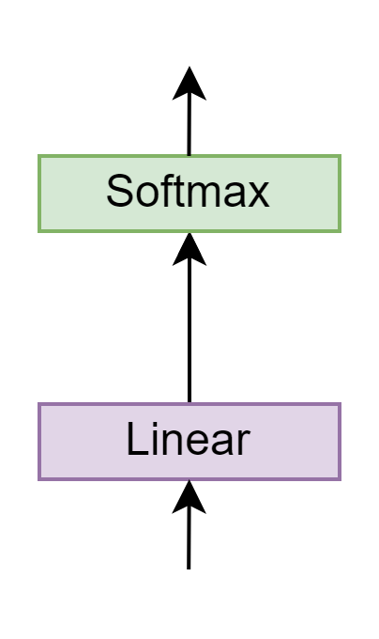




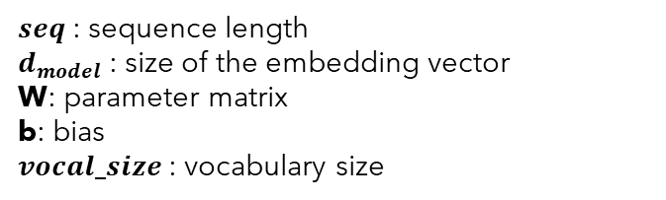









Projection
Target Tokenizer
$seq$ : sequence length
$d_{model}$ : size of the embedding vector
W: parameter matrix
b: bias
$vocal_size$: vocabulary size
{
…
"vocab": {
"[UNK]": 0,
"[PAD]": 1,
"[SOS]": 2,
"[EOS]": 3,
"la": 9,
"Je": 69 ,
"bien": 71,
"beaucoup": 324,
"vais": 600,
"fais": 1355,
"cuisine": 1390,
"Merci": 3546,
"française": 5309,
}
…
}
$$\left(batch, seq_{decoder},vocal_size\right)$$
$$\left(batch, seq_{decoder},vocal_size\right)$$
$$vocal_size=10000$$
$$W$$
Decoder Output
$$x$$
$$Linear\left(x\right)=$$
$$x$$
$$×$$
$$+$$
$$b$$
$$\left(batch, seq_{decoder}, d_{model}\right)$$
$$\left(seq,d_{model}\right)$$
$$\left(d_{model},vocal_size\right)$$

Slide 51
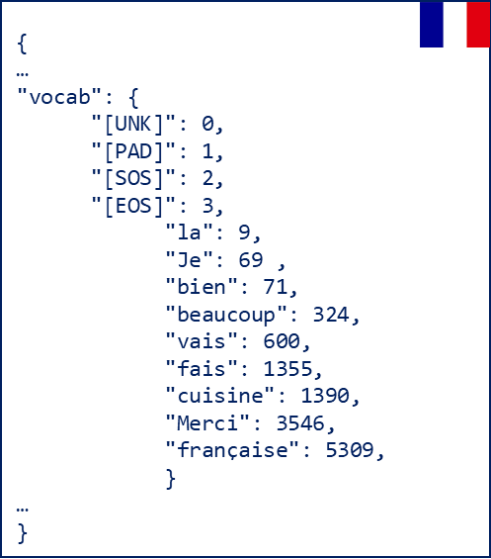
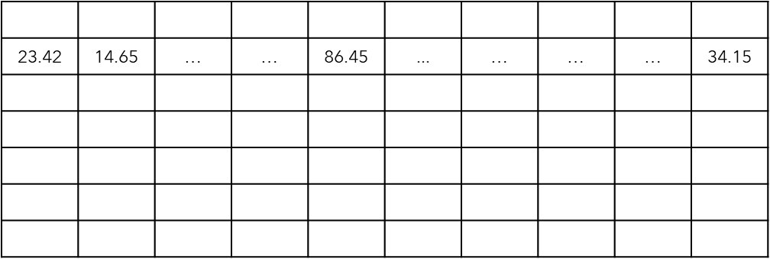
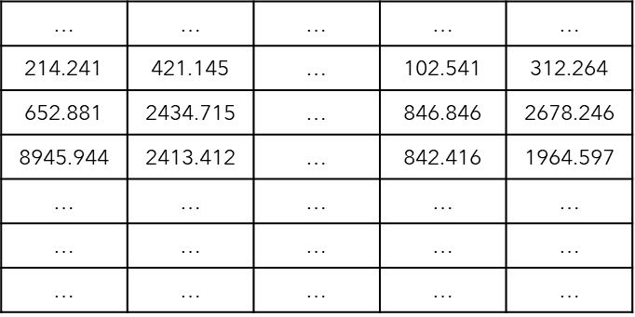








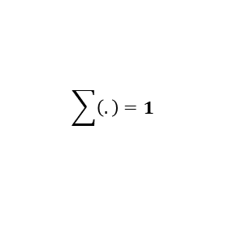

Transformer output example
Target Tokenizer
Je
decode
Softmax
$$index_{max}=69$$
$$vocal_size=10000$$
$$seq=7$$
0.03 | 0.04 | … | … | 0.86 | ... | … | … | … | 0.04
$$\sum{\left(.\right)}=1$$
$$vocal_size=10000$$
Linear
$$len=10000$$
3.42 | 4.65 | … | … | 86.45 | ... | … | … | … | 4.15
$$seq=7$$
$$len=10000$$
214.241 | 421.145 | … | 102.541 | 312.264
$$d_{model}=512$$
$$len=512$$

Slide 52

Transformer blocks
Projection
Decoder
Great Job!!
Encoder
Encoder Input
Decoder Input

Slide 53
Inference
t1
Je
Decoder
Encoder
<SOS> I am fine <EOS>
<SOS>
Source:
"I am fine"

Slide 54
Inference
t2
Je
Decoder
Encoder
<SOS> I am fine <EOS>
<SOS>
Source:
"I am fine"

Slide 55
Inference
t2
vais
Decoder
Encoder
<SOS> I am fine <EOS>
<SOS> Je
Source:
"I am fine"

Slide 56
Inference
t3
vais
Decoder
Encoder
<SOS> I am fine <EOS>
<SOS> Je
Source:
"I am fine"

Slide 57
Inference
t3
bien
Decoder
Encoder
<SOS> I am fine <EOS>
<SOS> Je vais
Source:
"I am fine"

Slide 58
Inference
t4
bien
Decoder
Encoder
<SOS> I am fine <EOS>
<SOS> Je vais
Source:
"I am fine"

Slide 59
Inference
t4
Prediction:
"Je vais bien"
EOS
Decoder
Encoder
<SOS> I am fine <EOS>
<SOS> Je vais bien
Source:
"I am fine"

Slide 60
Training
Target:
"Je vais bien"
t1
Je vais bien <EOS>
Cross Entropy Loss
X Y Z
Decoder
Encoder
Update model parameters
<SOS> I am fine <EOS>
<SOS> Je vais bien
Source:
Target:
"I am fine"
"Je vais bien"

Slide 61
Training
Target:
"Je t'aime"
t2
Je t'aime <EOS>
Cross Entropy Loss
A B C
Decoder
Encoder
Update model parameters
<SOS> I am fine <EOS>
<SOS> Je t'aime
Source:
Target:
"I love you"
"Je t'aime"

